Slide 1
XPath

Slide 2
Introduction to XPath
XPATH: XML Path Language
Is a query language
Uses
For selecting nodes from an XML document
Compute values
Version 1.0 and 2.0, (3.0 Recommendation on 8 April 2014)

Slide 3
XPath Examples
<?xml version="1.0" encoding="UTF-8"?>
<schools>
<releaseVersion>2.4</releaseVersion>
<school name="PICT">
<student id="123">
<name>Ritesh Deshmukh</name>
<age>34</age>
<year1>87</year1>
<year2>78</year2>
</student>
<student id="124">
<name>Gyanesh Deshpande</name>
<age>23</age>
<year1>50</year1>
<year2>63</year2>
</student>
</school>
<school name="COEP">
<student id="223523">
<name>Jaimeen</name>
<age>22</age>
<year1>60</year1>
<year2>80</year2>
</student>
</school>
</schools>
 | XPath | Value
Current Release Version | /schools/releaseVersion | 2.4
 | //releaseVersion | 2.4
Name 1st Student of 1st School | /schools/school[1]/student[1]/name | Ritesh Deshmukh
Id 1st Student of 1st School | /schools/school[1]/student[1]/@id | 123
Student whose id is 123 | /schools/school[1]/student[@id=123]/name | Ritesh Deshmukh
 | /schools/school/student[@id=123]/name | Ritesh Deshmukh
Total marks of Ritesh | (/schools/school/student[@id=123]/year1) +(/schools/school/student[@id=123]/year2) | 165
Average of Gyanesh | ( (/schools/school/student[@id=124]/year1) +(/schools/school/student[@id=124]/year2) ) div 2 | 56.5
Last student of PICT | /schools/school[@name='PICT']/student[last()]/name | Gyanesh Deshpande
Next Major Version | floor(//releaseVersion)+1 | 3
Next Minor Version Ful | concat(string(floor(//releaseVersion)+1),'.0') | 3.0
Total number of students in PICT | count(/schools/school[@name='PICT']/student) | 2
Agerage age of PICT | (sum(/schools/school[@name='PICT']/student/age) div count(/schools/school[@name='PICT']/student)) | 28.5
Last Student’s Age | /schools/school/student[@id=223523]/age | 22
 | //student[@id=223523]/age | 22

Slide 4
XPath Examples 2
<?xml version="1.0" encoding="UTF-8"?>
<schools releaseVersion="3.1">
<school name="PICT">
<student id="123">
<name>Ritesh Deshmukh</name>
<age>34</age>
<marks year="1">87</marks>
<marks year="2">78</marks>
</student>
<student id="124">
<name>Gyanesh Deshpande</name>
<age>23</age>
<marks year="1">50</marks>
<marks year="2">63</marks>
</student>
</school>
<school name="COEP">
<student id="223523">
<name>Jaimeen</name>
<age>22</age>
<marks year="1">60</marks>
<marks year="2">80</marks>
</student>
</school>
</schools>
 | XPath |  | Value
Student who has got less than 135 total marks | //student[sum(marks) < 135]/name |  | Gyanesh Deshpande
Number of students older than 30 years | count(/schools/school/student[age > 30]) |  | 1
 | count(/schools/school/student/age[. > 30])
Number of marks where student has got less than 75 marks | count(/schools/school/student/marks[. < 75]) |  | 3
Number of students who has got less than 75 in at least one year | count(/schools/school/student[marks < 75]) |  | 2
Name of students who has got less than 75 in at least one year | /schools/school/student[marks < 75]/name |  | Gyanesh Deshpande Jaimeen
Name of student(s) who has always got 75 or above | /schools/school/student[not(marks < 75)]/name |  | Ritesh Deshmukh
avg function will only work in x-path 2.0
Students younger than average of the school |  | /schools/school/ student[age<avg(../student/age)]/name | Gyanesh Deshpande
Students younger than average of all students |  | /schools/school/student [age<avg(../../school/student/age)]/name | Gyanesh Deshpande Jaimeen

Slide 5
XPath 2.0 Functions
String Functions
concat(string,string,...)
substring(string,start,len)
substring(string,start)
string-length(string)
normalize-space(string)
upper-case(string)
lower-case(string)
contains(string1,string2)
starts-with(string1,string2)
ends-with(string1,string2)
substring-before(string1,string2)
substring-after(string1,string2)
replace(string,pattern,replace)
tokenize(string,pattern)
Arithmetic Functions
abs(num)
ceiling(num)
floor(num)
round(num)
Aggregate Functions
count((item,item,...))
avg((arg,arg,...))
max((arg,arg,...))
min((arg,arg,...))
sum(arg,arg,...)
Sequence Functions
exists(item,item,...)
reverse((item,item,...))
DateTime
current-dateTime()
current-date()

Slide 6
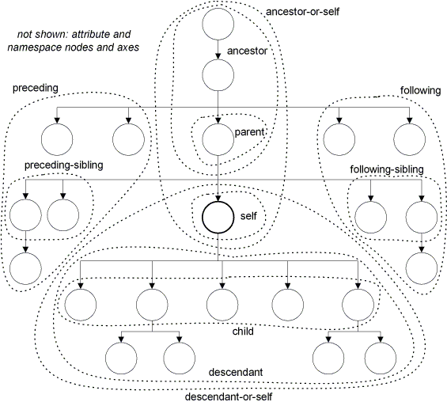
XPath Axis Specifiers
Source: http://nwalsh.com/docs/tutorials/xsl/xsl/foil22.html

Slide 7
XPath Examples 3
<?xml version="1.0" encoding="UTF-8"?>
<schools releaseVersion="3.1">
<school name="PICT">
<student id="123">
<name>Ritesh Deshmukh</name>
<age>34</age>
<marks year="1">87</marks>
<marks year="2">78</marks>
</student>
<student id="124">
<name>Gyanesh Deshpande</name>
<age>23</age>
<marks year="1">50</marks>
<marks year="2">63</marks>
</student>
</school>
<school name="COEP">
<student id="223523">
<name>Jaimeen</name>
<age>22</age>
<marks year="1">60</marks>
<marks year="2">80</marks>
</student>
</school>
</schools>
 | XPath | Value
Number of words in Student id 123’s Name | count(tokenize(//student[@id=123]/name,' ')) | 2
COPE Students Name | /schools/school[@name='COEP']/student/name | Jaimeen
 | //student[ancestor-or-self::school/@name='COEP']/name
 | //student[ancestor-or-self::*/@name='COEP']/name
Name of the student after student id 123 | /schools/school/student[@id=123]/following-sibling::student/name | Gyanesh Deshpande

Slide 8

Queries

Slide 9

Exercise
http://learn.onion.net/language=en/35426/w3c-xpath
Online xpath evaluator http://www.online-toolz.com/tools/xpath-editor.php

